Slide 1
User Management and SQL Server Security
CIS 483 – Database Security
Computer Information Systems
University of Louisville
Ghiyoung Im, PhD

Slide 2
Agenda
Authentication Methods
Managing Principals
Managing Securables
Managing Permissions

Slide 3
Using Windows Authentication Mode Using Mixed Mode
Authentication Methods

Slide 4
Using Windows Authentication Mode
SQL Server Authentication
The user logs in; Windows performs a DNS lookup to locate a key distribution center (KDC)
The user’s computer logs in to the domain
The KDC issues a ticket-granting ticket (a security token) to the user
The user’s computer sends the token to SQL Server
If the Windows SID is the same as that in sys.server_principals, the user is allowed to access

Slide 5
Using Mixed Mode
Mixed mode
Allows Windows Authentication, SQL Server Authentication
SQL Server Authentication
The user logs in the network (Windows or other)
The user connects to SQL Server using a separate id/pwd. It is called a nontrusted connection because SQL Server doesn’t use the OS authentication
SQL Server compares the credentials with the ones on the sys.sql_logins table
Access open to all: Unix users, Mac users, Novell users

Slide 6
Logins Users Roles
Managing Principals

Slide 7
Principals
Entities that can request SQL Server resources
Resources (e.g., logging in to manipulating data)
Encompasses logins of all types and roles
Permissions granted to an individual login or a role that the login belongs to
Each has SID
Each scoped at the Windows, server, or database level
Server principals: logins, server roles
Database principals: users, database roles

Slide 8
Principals at Three Levels
Level | Principals
Windows Level | Windows Domain Login Windows Local Login
SQL Server Level | SQL Server Login Server Role
Database Level | Database User Database Role Application Role

Slide 9
Logins
Each principal has an associated login (Windows accounts, Windows groups, or SQL Server logins)
Master database keeps logins, and permissions are granted to logins for resources at the server level
Access to database resources require additional permission via a database user (logins ≠ database user)
Logins at the SQL Server instance
WINDOWS LOGIN
WINDOWS GROUP: All members of the group granted or denied access
SQL LOGIN
SERVER_ROLE

Slide 10
Example Scenario
John is a member of a Windows group named Sales that has been granted access to SQL Server via a Windows group account in SQL Server. John should not have access to SQL Server, but he needs the permissions afforded the Sales group on other servers. How can you remedy this?
a. Create a new Windows group named SQL_Sales and add everyone but John to the group. Next, grant access to the SQL_Sales group by creating a group account in SQL Server, then remove the Sales group account from SQL Server.
b. Create a login on the SQL Server specifically for John, and deny the account access.
c. Delete the Sales group login, and create separate accounts for everyone except John.
d. Remove John from the Sales group in Windows, and grant him all the necessary permissions separately on all other servers on the network.

Slide 11
Logins - TSQL
-- Display server Principals
select * from sys.server_principals
-- Display server Principals
select left(name,25) name, type, type_desc
from sys.server_principals AS log
WHERE (log.type in ('U', 'G', 'S', 'R'))
order by 3,1
-- Display login, user, db names
select suser_name() as login
, user_name() as usr
, db_name() as db

Slide 12
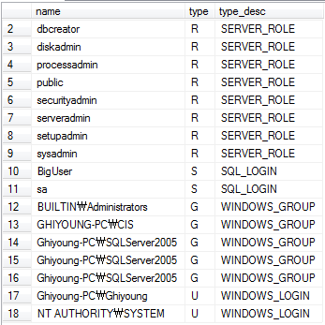
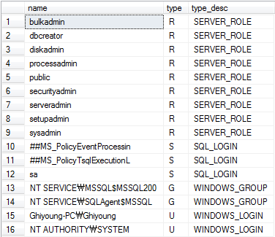
Logins Sample
2005 vs 2008

Slide 13
Logins at the Instance Level
sa account
SQL login (not Windows login)
A member of the sysadmin
Can be disabled
Recommendation: DON’T USE IT
BUILTIN\Administrators login
Local administrators group on the computer
A member of the sysadmin
Automatically added during installation; Not included in 2008 by default
NT AUTHORITY\SYSTEM login
Used to run SQL Server services (e.g., MS Update, service packs, and hotfixes)
A member of the sysadmin; Do not modify this account’s privileges
Certificate-based logins
Use to sign routines for more security
Starts with “##”

Slide 14
Logins Properties
All logins have
A default database
Default language: display error messages and functions
Server-level role:
Applied to the SQL Server instance
Inflexible
User mapping: database user
Securables
Status

Slide 15
Database Users
Database users
Principals at the database level
Having a user account does not mean you can access a particular table
The login name and the database user name are usually the same
A database user can be associated with a single login or a group
A user account for a login is not created by default
To display all the users in a database
select * from sys.database_principals

Slide 16
Built-in Database User Accounts
dbo
The database owner
The sysadmin fixed server is mapped to the special user dbo in each database. Any object created by any member of the sysadmin fixed server role belongs to dbo automatically.
guest
Disabled by default; If enabled, any login can use the database without a user account
INFORMATION_SCHEMA
Internal usage
sys
Internal usage

Slide 17
dbo Example
If user John is a member of the sysadmin fixed server role and creates a table Employee, Employee belongs to ___ and is qualified as ___.Employee, not as ____.Employee.
If John is not a member of the sysadmin fixed server role but is a member only of the db_owner fixed database role and creates a table Employee, Employee belongs to ____ and is qualified as ____.Employee. The table belongs to ___ because he did not qualify the table as ___.Employee.

Slide 18
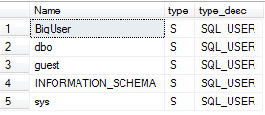
User Accounts - TSQL
To display all the users in a database
select * from sys.database_principals
SELECT left(u.name,25) AS [Name], type, left(type_desc,15) as type_desc
FROM sys.database_principals AS u
WHERE (u.type in ('U', 'S', 'G'))
ORDER BY 1

Slide 19
Roles
Similar to groups in Windows
Logins or users can be grouped into a “Role” and then permissions assigned to the role
SQL Server has the following three types of roles:
Fixed-server and fixed-database roles
Installed by default and have fixed permissions
User-defined roles
Create a custom set of permissions
Per database
Application roles
Manage database access for an application

Slide 20
Fixed Server Roles (1/3)
Permissions for these roles are related to server-level securables
Logins, not database users, are assigned to these roles
A single login can be assigned to multiple fixed-server roles
Permissions for these roles are cascaded to the database level

Slide 21
Fixed Server Roles (2/3)
Roles | Description
sysadmin | Can conduct any task in SQL Server DBAs
serveradmin | Change serverwide configuration options (e.g., memory usage limit) Assistant DBAs
setupadmin | Can install replication and manage extended stored procedures Assistant DBAs
securityadmin | Can manage security issues (logins creation and deletion, audit logs reading, db creation permission granting) Assistant DBAs

Slide 22
Fixed Server Roles (3/3)
Roles | Description
processadmin | Kill a process Assistant DBAs and developers
dbcreator | Can create and make changes to databases Assistant DBAs as well as developers Don’t use it (members can DROP any database on the server)
diskadmin | Can manage files on disk (mirroring, adding backup devices) Assistant DBAs
bulkadmin | Can execute the BULK INSERT statement (importing data into databases from text files) Assistant DBAs

Slide 23
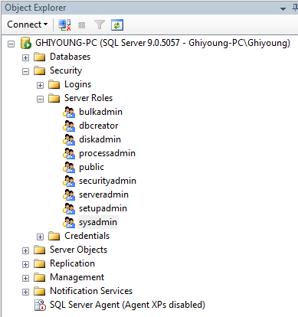
Fixed-Server Roles in Object Explorer

Slide 24
Fixed Database Roles
Fixed permissions at the database level
Assigned to database users

Slide 25
Fixed Database Roles
Role | Permission
db_accessadmin | Allowed to add or remove database access for logins.
db_backupoperator | Allowed to back up the database.
db_datareader | Allowed to read all user table data.
db_datawriter | Allowed to change the data in all user tables.
db_ddladmin | Allowed to run any Data Definition Language (DDL) command against the database. This includes commands to Create, Alter, and Drop database objects.
db_denydatareader | Denied the right to read all user table data.
db_denydatawriter | Denied the right to change the data in any of the user tables.
db_owner | Allowed to perform any action on the database. Members of the sysadmin fixed-server role are mapped to this database role.
db_securityadmin | Allowed to manage permissions for database users, including membership in roles.

Slide 26
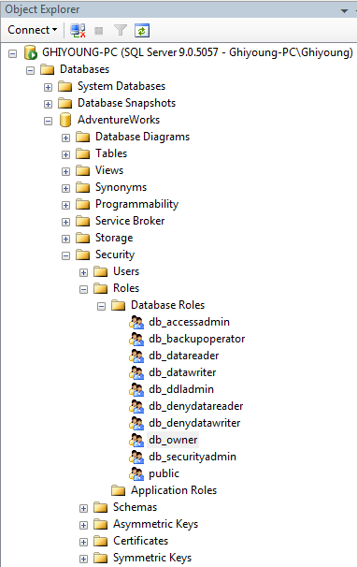
Fixed Database Roles in Object Explorer

Slide 27
The public Role
The public role
Like everyone group in Windows
This role is assigned to every user in a database
Guest user vs Public role
Guest user => Does not require a specific login; any login can use permissions granted to the guest user
Public role => Requires a specific login; the login uses any permissions granted to the public role.

Slide 28
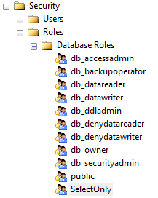
User Defined Roles
Create custom database roles
Make the more granular set of permissions

Slide 29
User Defined Roles
How can we grant “read all the tables in a database”, but “update only one table”?
Hint: Utilize db_datareader, db_datawriter roles
(1) Give each user db_datareader and the specific UPDATE permission
-> tedious
(2) Put users in a Windows group and assign a login and database user with the proper permissions
-> not always feasible
(3) Create a user-defined database role that contains db_datareader role, and the UPDATE permission to the single table
-> good

Slide 30
Application Roles
A database principal that allows an application to run with its own permissions
The steps for the app role switches the contexts:
A user runs an application
The application connects to an instance of SQL Server as the user
The application runs sp_setapprole with a password known only to the application
Here the connection assumes the permissions of the application role (not the user)
For stateful Windows apps, not stateless web apps (not common uasge)

Slide 31
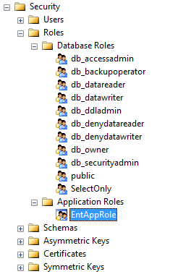
Sample Application Role

Slide 32
Managing Securables

Slide 33
Securables
Resources on which permissions can be granted. Principals (e.g., users, logins) acquire permission to securables.
Some securables contained within others and form nested hierarchies called “scopes”
Relationships can span scope boundaries
Servers have databases; databases have schemas; and schemas have contain objects
If permissions granted on a securable at the server level, implied permissions granted at the database and schema levels

Slide 34
Securables
Scope | Securables
Server | Logins Databases
Database | User Role Application role Schemas
Schema | Table View Function Procedure Queue Type Synonym Aggregate

Slide 35
Managing Permissions

Slide 36
Permissions
Permissions are granted to a principal on securables
Permissions manipulated with the TSQL queries: GRANT, DENY, and REVOKE
GRANT: allows an operation on an object
DENY: denies permission on an object
REVOKE: removes a (granted/denied) permission
Combination of login, user and role permissions determine GRANT or DENY
A single DENY stops access

Slide 37
Permissions - TSQL
First, identify info
SELECT SUSER_SNAME() AS Login
, USER_NAME() AS Usr
, DB_NAME() AS Db
Next, examine permissions
select * from sys.server_permissions
select * from sys.database_permissions

Slide 38
Permissions
GRANT/REVOKE/DENY | Description
CREATE
ALTER | Confer the ability to change the securable’s properties (not ownership)
DROP
CONTROL | Give ownership-like capabilities to the grantee; The grantee effectively has all defined permissions on the securable
CONNECT
SELECT
EXECUTE | Execute a stored procedure
UPDATE
DELETE
INSERT
REFERENCES | Create a foreign key constraint
RECEIVE
VIEW DEFINITION | Provide access to SQL Server metadata
TAKE OWNERSHIP | Take ownership of the securable

Slide 39
Basic Permissions for Securables
CONTROL
Gives ownership-like rights
--Give the login John sysadmin-level rights
GRANT CONTROL SERVER TO John
ALTER
Gives ability to modify
--Give the login John the ability to change William’s password
GRANT ALTER ON LOGIN::William TO John
VIEW DEFINITION
Allows for viewing (source code, login info, table metadata) if given at the table level
--Give the login John the ability to view information about William’s login
GRANT VIEW DEFINITION ON LOGIN:: William TO John

Slide 40
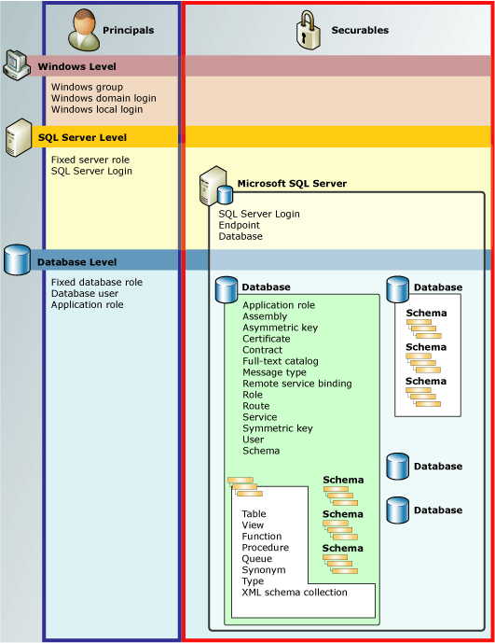
Permissions Hierarchy

Slide 41
GRANT, DENY, REVOKE
Deny stops access
Users require permission to execute an action
Roles of users provide permissions

Slide 42
Permissions Example
Let’s assume that John is a user of the SalesDB.
The public in the database has DENY SELECT on dbo.Product
John is assigned to db_datareader
John’s permissions on the user account are as follows
GRANT SELECT on dbo.Product
GRANT UPDATE on dbo.Customer
Q: What are John’s effective permissions?

Slide 43
New Security & User Admin in 2008
BUILTIN\Administrators
This local Windows group eliminated from the SQL Server sysadmin fixed server role
Surface Area Configuration (SAC)
Can handle configuration using Policy-Based Management & enhanced SQL Server Configuration Manager
Local Groups Removed from sysadmin
Removed: SQLServerMSSQLUser$ COMPUTERNAME $ INSTANCENAME & SQLServerSQLAgentUser$ COMPUTERNAME $ INSTANCENAME
Added: SQL Server Service and SQL Server Agent Service

Slide 44
How to Create Schemas?
What is schema? – Container of objects
First, create a database
Next, create a schema
Path: AdventureWorks / Security / Right-click Schema

Slide 45
Next Week
Midterm Exam Review

